Slide 1



MC2200/MC2700
Configuration & Accessories Guide
Version 1.1
October 23, 2020
ZEBRA and the stylized Zebra head are trademarks of Zebra Technologies Corp., registered in many jurisdictions worldwide. All other trademarks are the property of their respective owners. ©2019 Zebra Technologies Corp. and/or its affiliates. All rights reserved.

Slide 2
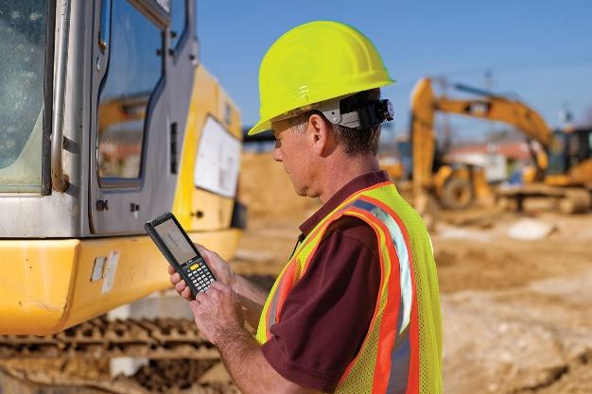
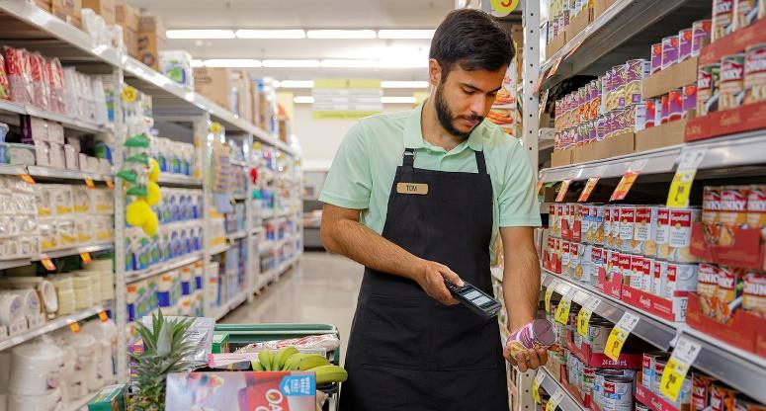
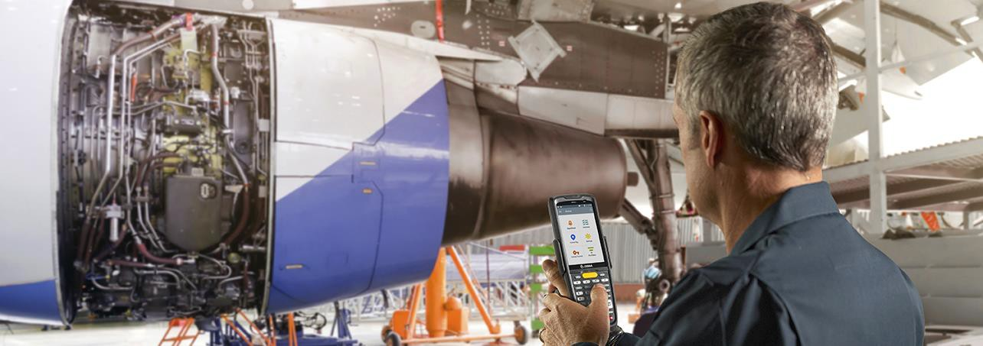
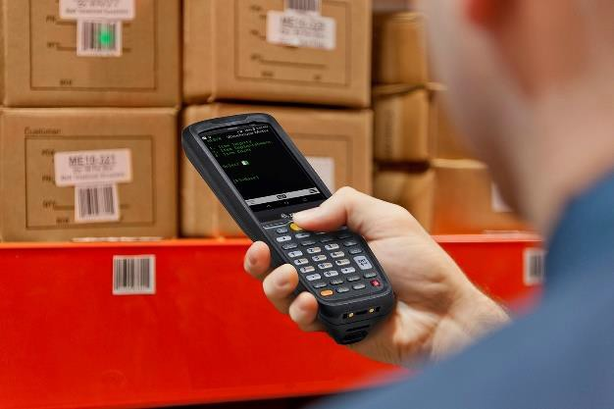
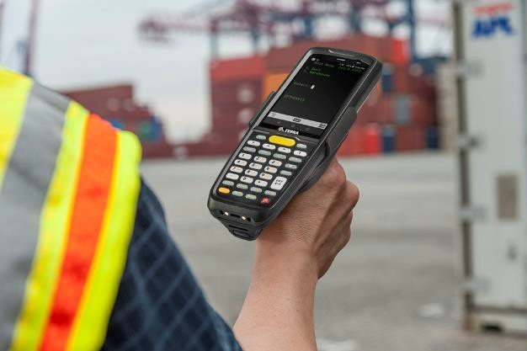

Contents
MC2200/MC2700 Series Configuration Guide
MC2200/MC2700 Series Accessories Guide
ZEBRA TECHNOLOGIES

Slide 3
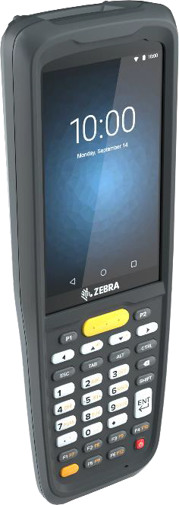
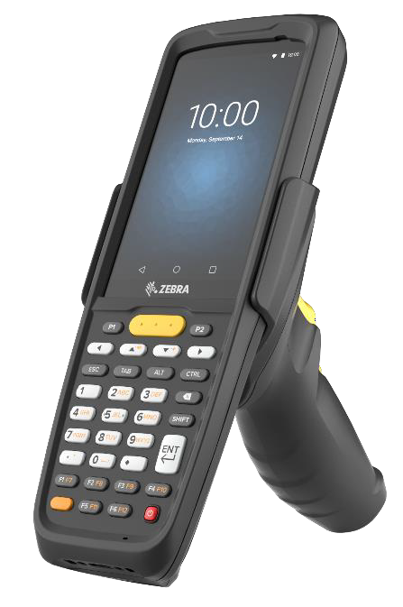
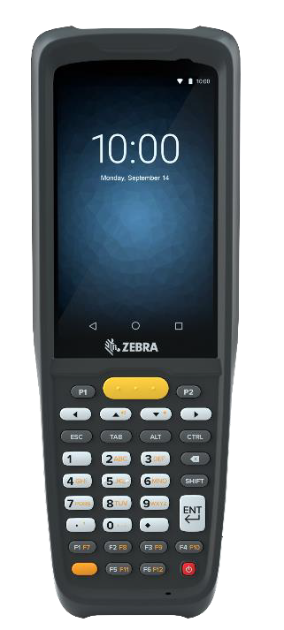
MC2200/MC2700
Configuration Guide
ZEBRA TECHNOLOGIES

Slide 4
MC2200/MC2700 Configuration Matrix
Configuration Options | MC2X | Option | Description
Network Version | MC22XX-XXXXXXX MC27XX-XXXXXXX | 2 7 | WLAN Only WWAN-WLAN
WAN | MC2X0X-XXXXXXX MC2XAX-XXXXXXX MC2XBX-XXXXXXX MC2XCX-XXXXXXX | 0 A B C | LAN Only Multi-Operator, HSPA+ / LTE (Americas + Canada), GPS Multi-Operator, GSM/HSPA+ / LTE, (ROW: EMEA + APAC), GPS Multi-Operator, GSM/HSPA+ / LTE, (China), GPS
LAN & PAN | MC2XXJ-XXXXXXX MC2XXK-XXXXXXX | J K | 802.11a/b/g/n/d/h/i/k/r/ac + BT 5.x no NFC 802.11a/b/g/n/d/h/i/k/r/ac + BT 5.x with NFC
Operating System | MC2XXX-2XXXXXX MC2XXX-3XXXXXX MC2XXX-4XXXXXX | 2 3 4 | Android GMS Android AOSP (Non-GMS) Android GMS with eSIM Support
Data Capture | MC2XXX-XAXXXXX MC2XXX-XBXXXXX | A B | SE4100 Scanner SE4100 Scanner + 13MP Rear Facing Camera with Flash
Keypad | MC2XXX-XX3XXXX | 3 | 34 (FN Numeric)
Battery | MC2XXX-XXXSXXX MC2XXX-XXXEXXX | S E | Standard Extended
Memory / Haptic | MC2XXX-XXXX2XX MC2XXX-XXXX3XX MC2XXX-XXXX4XX | 2 3 4 | 2GB/16GB 3GB/32GB 3GB/32GB with Vibrator (China specific SKUs only)
Country | MC2XXX-XXXXXBR MC2XXX-XXXXXCN MC2XXX-XXXXXIN MC2XXX-XXXXXNA MC2XXX-XXXXXRU MC2XXX-XXXXXRW MC2XXX-XXXXXTR MC2XXX-XXXXXXP | BR CN IN NA RU RW TR XP | Brazil (Req'd for WWAN Only) China (WWAN / WLAN) India (WWAN / WLAN) North America (Canada, USA, PR) (WWAN / WLAN) Russia (WLAN / WWAN) Rest Of World WLAN / WWAN Turkey (WLAN / WWAN) PTT-Removed (Push-To-Talk) (WLAN/WWAN)
ZEBRA TECHNOLOGIES

Slide 5
MC2200/MC2700
Accessory Guide
ZEBRA TECHNOLOGIES

Slide 6
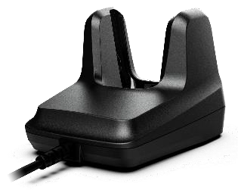
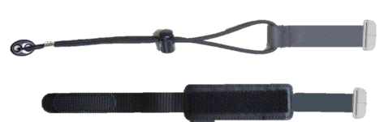
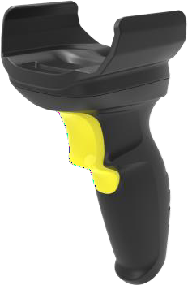
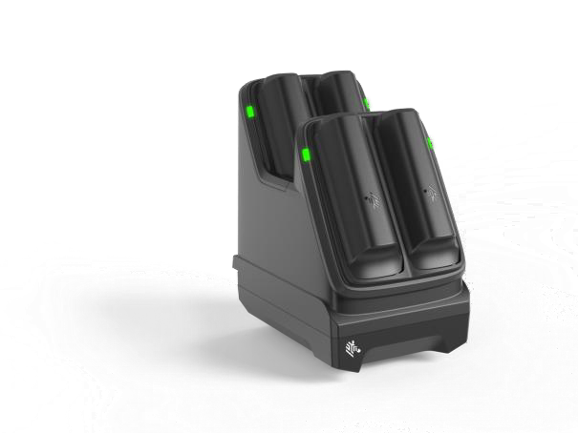
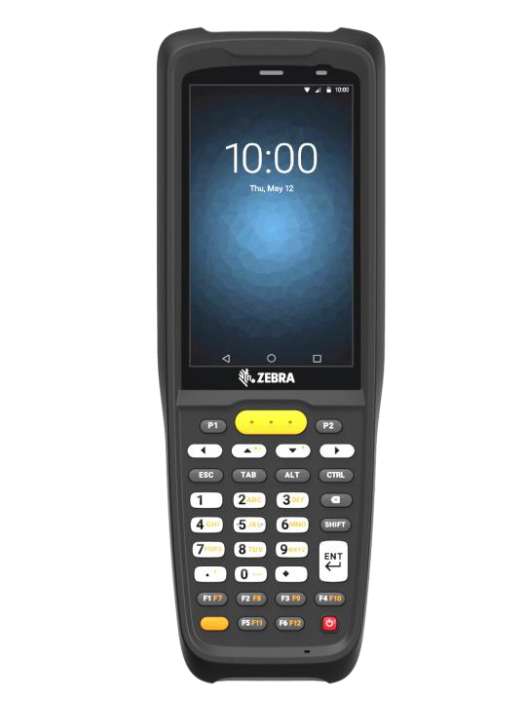

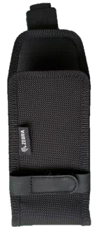
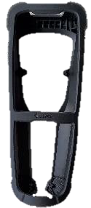
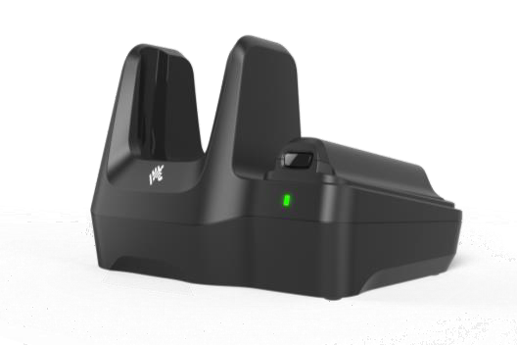
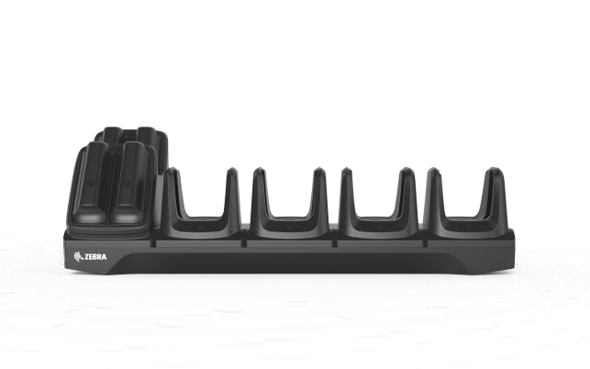
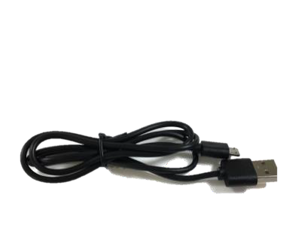
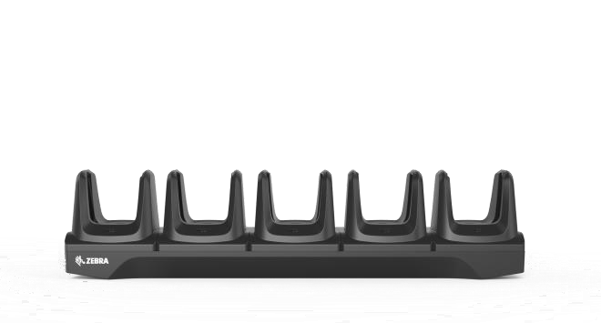
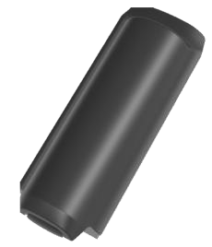


MC2200 / MC2700 Accessory Overview
Built for work to get the job done across your business with accessories that enable better backroom management and expanded flexibility
Low-Cost Desktop USB-C Cradle
Attachable Trigger Handle
Hand Strap
4 Slot Battery Charger
Screen Protector
Holsters and Rubber Boots
Single Slot Desktop Cradle with Spare Battery Charger. Supports optional Ethernet Module
Two Battery Options (3500mAh & 4900mAh)
Multi-Slot Cradle System (Two Options; 5 Terminal,
4 Terminal & 4 Battery Charger)
USB-C Charge Cable
©2020 Zebra Technologies. Confidential.

Slide 7
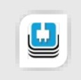
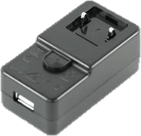
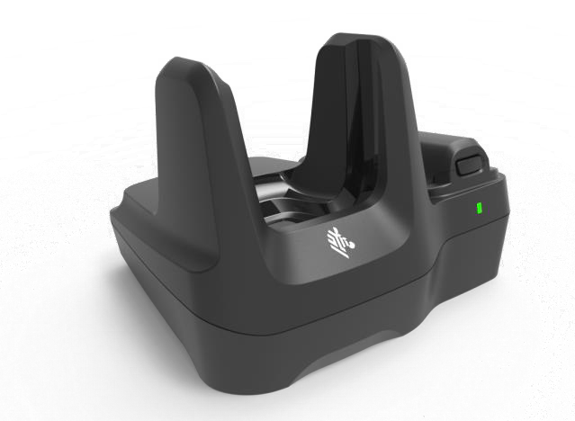
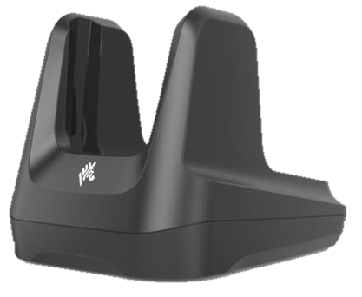

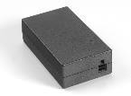


Cradle System
Single Slot Cradle
Additional Accessories for Device-only Single Slot Cradle
PWR-WUA5V12W0XX AC/DC power supply AC Input: 100-240VAC DC Output: 5VDC, 2.5A, 12.5W |  | World-Wide: | PWR-WUA5V12W0WW
 | Australia: PWR-WUA5V12W0AU Brazil: PWR-WUA5V12W0BR China: PWR-WUA5V12W0CN Europe: PWR-WUA5V12W0EU India: PWR-WUA5V12W0IN Korea: PWR-WUA5V12W0KR UK: PWR-WUA5V12W0GB
Additional Accessories for Single Slot Cradle with Spare Battery Charger
MOD-MT2-EU1-01 USB To Ethernet Module. Mechanical switch selects between USB port and RJ45 Ethernet jack. PWR-BGA12V50W0WW Level VI AC/DC power supply (brick, replacement for PWRS-14000-148R) AC Input: 100-240VAC, 2.4A DC Output: 12VDC, 4.16A, 50W Requires: DC line cord and country specific grounded AC line cord. CBL-DC-388A1-01 DC line cord for running the single slot cradles or battery chargers from a single Level VI power supply PWR-BGA12V50W0WW, Level VI replacement for PWRS-14000-148R. Various Part Numbers – please contact your Zebra sales associate for more details AC line cord, 7.5 feet long, grounded, three wire for power supplies.
Single Slot Cradle Options:
CRD-MC2X-1SCU-01
Single slot USB cradle charges one device. Allows USB communication to the device with integrated 1m (3.3’) USB-A cable.
Optional: Power supply PWR-WUA5V12W0XX for charge only. Country specific part numbers are available for order
CRD-MC2X-2SUCHG-01
Single slot USB cradle with spare battery charging, charges one device and one spare battery. Allows USB or ethernet communication to the device with an additional micro-USB cable (25-124330-01R) or ethernet dongle (MOD-MT2-EU1-01).
Requires: Power supply PWR-BGA12V50W0WW, DC line cord
CBL-DC-388A1-01 and country specific 3 wire AC line cord.
ZEBRA TECHNOLOGIES

Slide 8
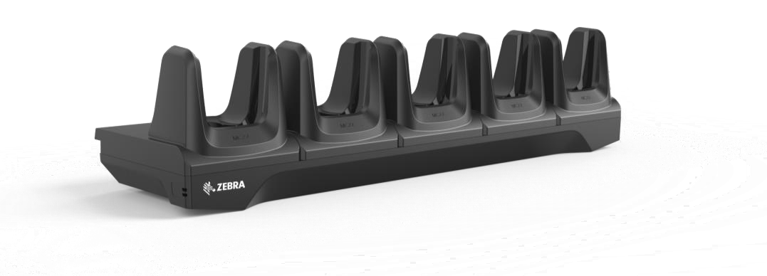
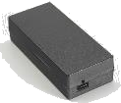
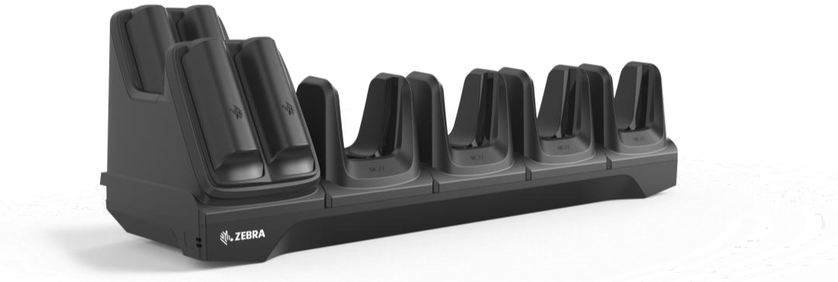



Main Features
Cradle System
Multi-slot Cradles
Charge only configurations
Charges five devices or four devices with four spare batteries
Compatible with all MC2200/MC2700 batteries (in device & in spare charger)
Desk/Wall/Rack mount options
Additional Accessories for Single Slot Cradle
PWR-BGA12V108W0WW
Level VI AC/DC power supply (brick, Replacement for PWRS-14000-241R)
AC Input: 100-240V, 2.8A
DC Output: 12V, 9A, 108W
Requires: DC line cord and country specific grounded AC line cord.
CBL-DC-381A1-01
DC line cord for running multi-slot cradles from a single Level VI power supply PWR-BGA12V108W0WW, Level VI replacement for PWRS-14000-241R
23844-00-00R
US AC line cord, 7.5 feet long, grounded, three wire for power supplies.
BRKT-SCRD-SMRK-01
Rack/Wall mounting bracket, allows to install any multi-slot cradle on a wall or a 19” IT rack.
Multi-Slot Cradle Options:
CRD-MC2X-5SCHG-01
5-Slot Terminal Charger.
CRD-MC2X-4SC4BC-01
4-Slot Terminal Charger with 4-Slot Battery Charging.
All Multi-Slot Cradles Require: Power supply PWR- BGA12V108W0WW, DC cord CBL-DC-381A1-01 and country specific 3 wire AC line cord.
ZEBRA TECHNOLOGIES

Slide 9
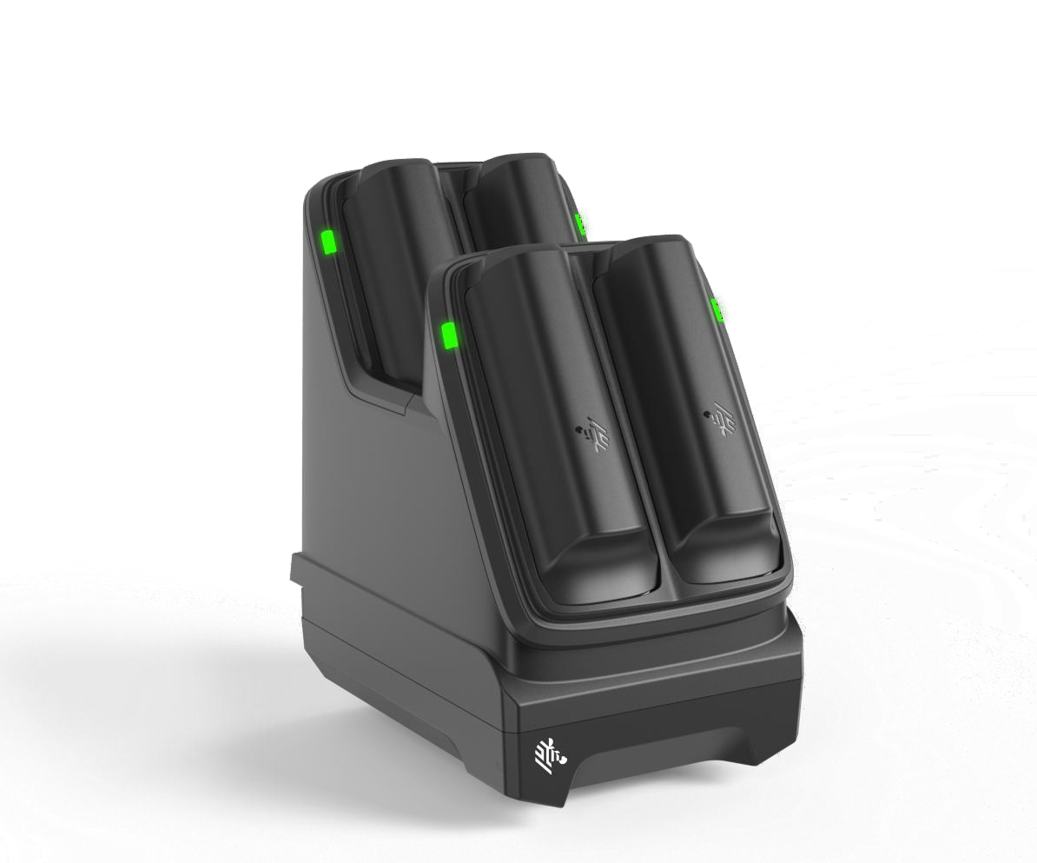

Main Features
Cradle System
Multi-slot Battery Charger
Charge only configurations
Charges four spare batteries
Compatible with all MC2200/MC2700 batteries
Additional Accessories for Single Slot Cradle
PWR-BGA12V50W0WW
Level VI AC/DC power supply (brick, replacement for PWRS-14000-148R)
AC Input: 100-240VAC, 2.4A
DC Output: 12VDC, 4.16A, 50W
Requires: DC line cord and country specific grounded
AC line cord.
CBL-DC-388A1-01
DC line cord for running the single slot cradles or battery chargers from a single Level VI power supply PWR-BGA12V50W0WW, Level VI replacement for PWRS-14000-148R.
Various Part Numbers – please contact your Zebra sales associate for more details
AC line cord, 7.5 feet long, grounded, three wire for power
supplies.
Multi-Slot Battery Charger:
SAC-MC2X-4SCHG-01
4-Slot Battery Charger, Charges Four Spare Batteries (Supports both
Standard and Extended Capacity Batteries)
Multi-Slot Battery Cradle Requires: Power supply PWR- BGA12V50W0WW, DC cord CBL-DC-388A1-01 and country specific 3 wire AC line cord.
ZEBRA TECHNOLOGIES

Slide 10
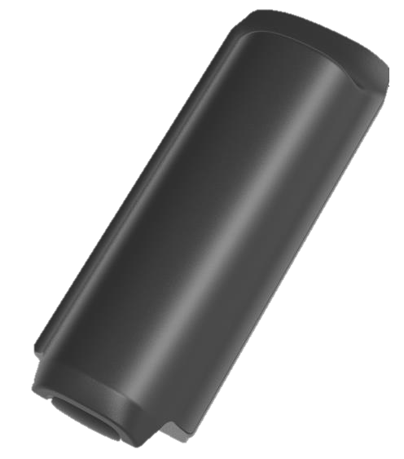
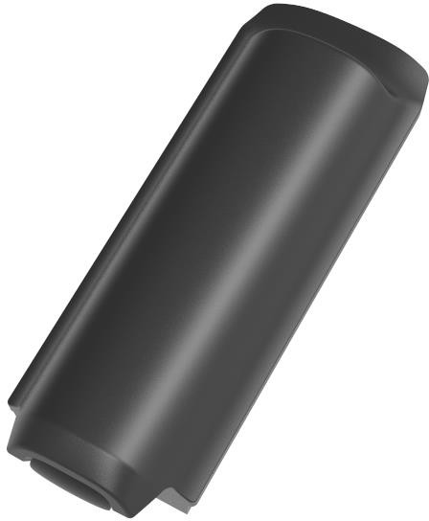


Batteries
Spare Batteries – Standard / Extended Capacity
BTRY-MC2X-35MA-01
PowerPrecision Lithium Ion battery pack, 3500mAh, provides 17 hours of use at room temperature before requiring a recharge
BTRY-MC2X-49MA-01
PowerPrecision Lithium Ion battery pack, 4900mAh, extended capacity provides over 23 hours of use at room temperature before requiring a recharge
Pack of 10: BTRY-MC2X-35MA-10
Pack of 10: BTRY-MC2X-49MA-10
Note: 4900mAh battery pack is denoted by the battery plus icon to
differentiate from the 3500mAh standard battery
ZEBRA TECHNOLOGIES

Slide 11

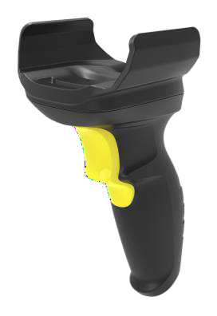

Data Capture
Attachable Trigger Handle
Screen Protector
TRG-MC2X-SNP1-01
Attachable trigger handle
MISC-MC2X-SCRNPT-01
Tempered Glass Screen Protector - 5 Pack
Protects displays on both MC2200 and MC2700
Quickly converts your device into a gun style for data capture intensive applications.
The handle easily snaps onto the device, no tools required.
2-pin electrical interface provides fast data capture.
Does not block camera or any other feature
Works in all charging cradles with handle attached
Optional wrist strap (SG-MC2X-HSTRPH-01), rubber boot (SG-MC2X-RBH2-01) and holster (SG-MC3021212- 01R) available
ZEBRA TECHNOLOGIES

Slide 12

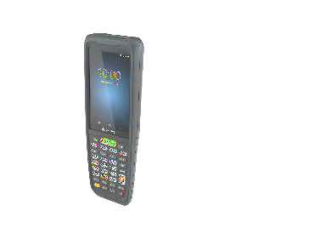

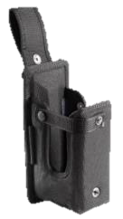
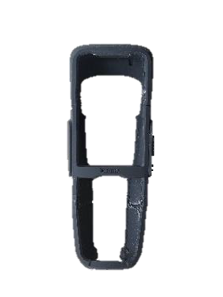
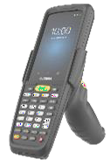


Soft Goods
Brick and Gun Configurations
Carrying Solutions
SG-MC2X-HLSTR-01 Fabric holster, secures to a belt or a shoulder strap – belt clip included. The shoulder strap can be purchased separately
SG-MC3021212-01R Fabric holster, secures to a belt or a shoulder strap.. Requires belt or shoulder strap ordered separately.
Protective Boots
SG-MC2X-RB1-01 Rubber boot for terminal only, protects the device from wear and.
SG-MC2X-RBH2-01 Rubber boot for terminal with trigger handle, protects the device from wear and.
Straps
SG-MC2X-HSTRP-01 Spare Hand Strap for Terminal without Trigger Handle
SG-MC2X-HSTRPH-01 Hand Strap for Terminal with Trigger Handle
Brick-only
Gun-only
Other
58-40000-007R
Shoulder strap
Universal shoulder strap for fabric holster.
11-08062-02R
Belt for holster Universal belt for fabric holster.
ZEBRA TECHNOLOGIES

Slide 13
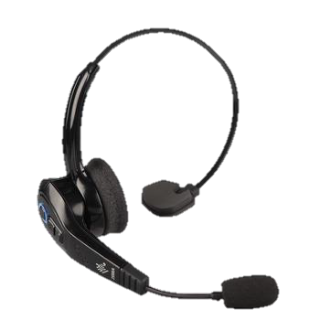
Audio Accessories
Bluetooth Headset
HS3100-OTH
HS3100 Rugged Bluetooth Headset Over-The-Head
Headband includes
HS3100 Boom Module
HSX100 OTH Headband Module
ZEBRA TECHNOLOGIES

Slide 14
Other Accessories
Country specific AC grounded line cords
Part Number Description
Country specific wall adapters
 | Part Number | Description
 | PWR-WUA5V12W0WW | Level VI power supply (wall adapter) 100-240 VAC, 5V, 2.5A with adapter plugs for world-wide use
 | PWR-WUA5V12W0AU | Level VI power supply (wall adapter) 100-240 VAC, 5V, 2.5A with Australia plug
 | PWR-WUA5V12W0BR | Level VI power supply (wall adapter) 100-240 VAC, 5V, 2.5 A with Brazil plug
 | PWR-WUA5V12W0CN | Level VI power supply (wall adapter) 100-240 VAC, 5V, 2.5A with China plug
 | PWR-WUA5V12W0EU | Level VI power supply (wall adapter) 100-240 VAC, 5V, 2.5A with Europe plug
 | PWR-WUA5V12W0GB | Level VI power supply (wall adapter) 100-240 VAC, 5V, 2.5A with UK plug
 | PWR-WUA5V12W0IN | Level VI power supply (wall adapter) 100-240 VAC, 5V, 2.5A with India plug
 | PWR-WUA5V12W0KR | Level VI power supply (wall adapter) 100-240 VAC, 5V, 2.5A with Korea plug
 | PWR-WUA5V12W0US | Level VI power supply (wall adapter) 100-240 VAC, 5V, 2.5A with US plug
23844-00-00R
AC line cord, 7.5 feet long, grounded, three wire. Associated Country: US
50-16000-217R
AC Line Cord, 1.9M, grounded, three wire, AS 3112 plug. Associated Country: Australia, New Guinea
50-16000-218R
AC Line Cord, 1.8M, grounded, three wire, NEMA 1-15P plug. Associated Country: Japan
50-16000-219R
AC Line Cord, 1.8M, three wire, grounded BS1363 plug. Associated Countries: Hong Kong, Iraq, Malaysia, Singapore, United Kingdom
AC Line Cord, 1.8M, grounded, three wire CEE 7/7plug. Associated Countries: Europe, Abu Dhabi, Bolivia, Dubai, Egypt, Iran, Korea, Russia, Vietnam
50-16000-220R
50-16000-256R
AC Line Cord, 1.8M, grounded, three wire, CEE7/7 plug. Associated Country: Korea
50-16000-257R
AC Line Cord, 1.8M, grounded, three wire, IEC 60320 C13 plug. Associated Country: China
50-16000-669R
AC Lind Cord, 1.9 M grounded, three wire, BS 546 Plug. Associated Country: India
50-16000-671R
AC Line Cord, 1.8M grounded, CIE 23-16 plug. Associated Country: Italy
50-16000-672R
AC Line Cord, 1.9M grounded, three wire, S132 Plug. Associated Country: Israel
50-16000-727R
AC Line Cord, 1.9M grounded, three wire. Associated Country: Brazil
ZEBRA TECHNOLOGIES

Slide 15

ZEBRA and the stylized Zebra head are trademarks of Zebra Technologies Corp., registered in many jurisdictions worldwide. All other trademarks are the property of their respective owners. ©2020 Zebra Technologies Corp. and/or its affiliates. All rights reserved.

