Slide 1
TC21 and TC26
Accessory Guide

Slide 2
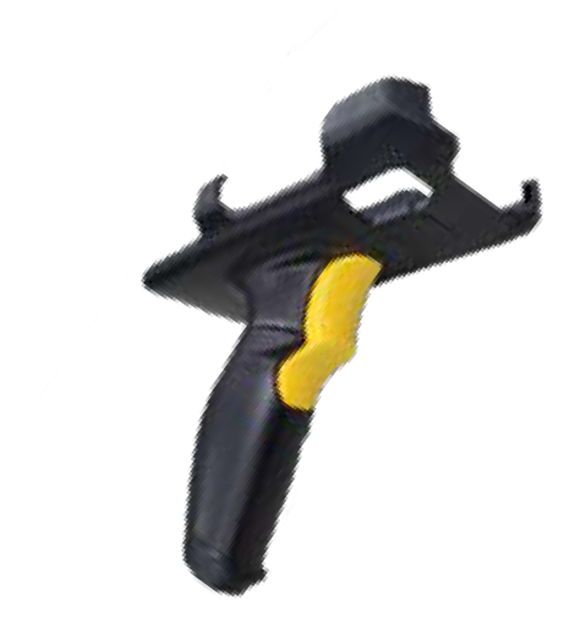

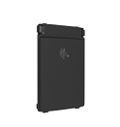
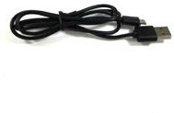
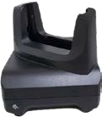


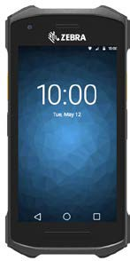
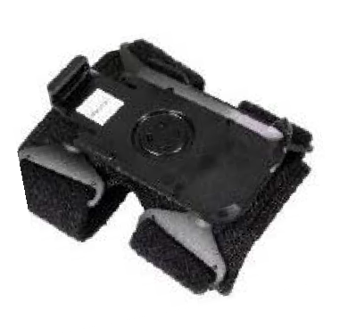


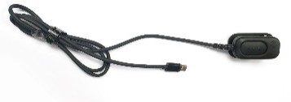
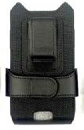
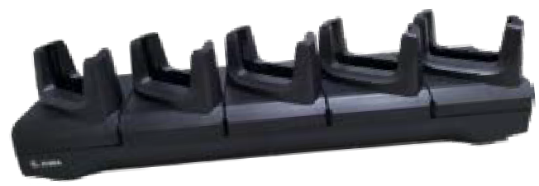
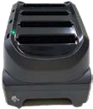

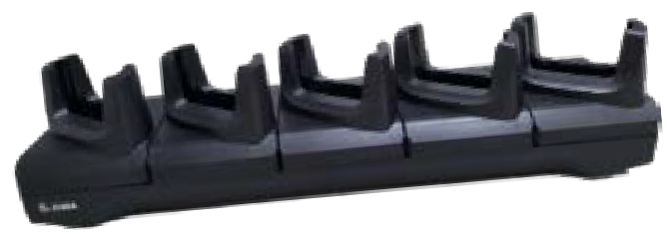

TC21/TC26 Accessory Overview
Snap on Trigger Handle
Low-Cost Single Slot Charge Cradle
USB Charge Cable
Batteries
(3100 mAh, 5400 mAh)
Hand Strap
Screen Protector
Low-Cost Single Slot Communication Cradle
Wearable Arm Mount
RS5100 Ring Scanner
USB-C Audio adapter w/PTT Button
Holster
Multi-Slot Charge only Share Cradle
20 slot Battery Charger
Multi-Slot Ethernet Share Cradle
4 slot Battery Charger
Vehicle Holder

Slide 3



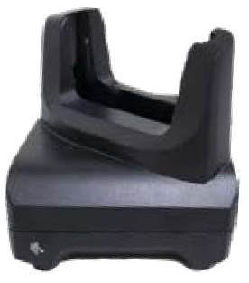
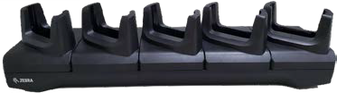
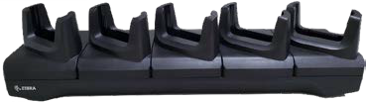

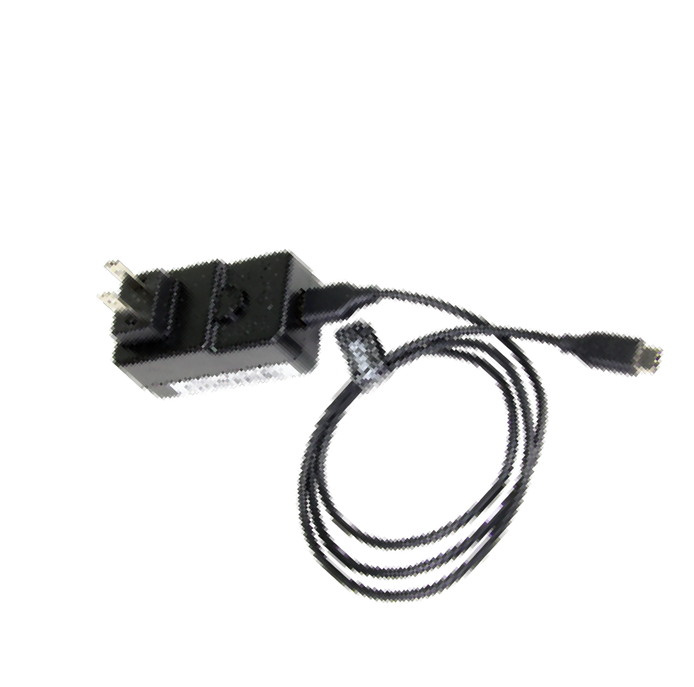


Cradle System
 | 1 & 5 Slot Charge Cradles
 | CRD-TC2Y-BS1CO-01 | CRD-TC2Y-BS5CO-01
 |  | CRD-TC2Y-BS54B-01
 | TC21/TC26 Single Slot Charge | TC21/TC26 Multi-Slot Charge Only
 | Only Cradle | ShareCradle
 | Charges Trigger Handle and Terminal together
 | Multi-slot - 19” Rack: Rack Mountable (Mounting
 | accessory required - BRKT-SCRD-SMRK-01)
 | 5-slot available in 2 options;
 | 5 slot terminal only
 | 4 slot terminal plus 4 slot battery
 | Single Slot Base Cradle requires USB C Cable
 | (CBL-TC5X-USBC2A-01, PS: PWR-
 | WUA5V12W0XX (US, EU, GB, AU, CN, BR, KR,
 | IN)
 | 5-Slot Cradles requires power supply PWR-
 | BGA12V108W0WW, DC Line Cord CBL-DC-
 | 381A1-0 & country specific AC Line Cord (sold
 | separately)
1 & 5-Slot Communication Cradles
CRD-TC2Y-SE1ET-01
TC21/TC26 Single Slot Charge/Communication Cradle
CRD-TC2Y-SE5ET-01
TC21/TC26 5-Slot Ethernet & Charge ShareCradle
Charge Trigger Handle and Terminal Together
Multi-slot 19-inch Rack Mountable (Mounting accessory required - BRKT-SCRD-SMRK-01)
NOTE: Single Slot Communication Cradle to utilize Ethernet requires MOD-MT2-EU1-0 or to utilize USB requires UBB cable 25-124330-01R. (Both Sold Separately)
Single Slot Charge and Ethernet Communication Cradle requires power supply PWR-BGA12V50W0WW & CBL- DC-388A1-01 & country specific AC Line Cord (sold separately)
5-Slot Cradles requires power supply PWR- BGA12V108W0WW, DC Line Cord CBL-DC-381A1-0 & country specific AC Line Cord (sold separately)

Slide 4




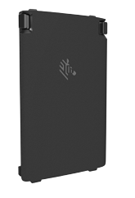
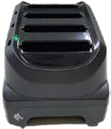
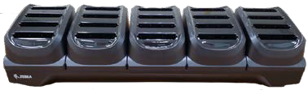
Batteries and Chargers
4-Slot Battery Charger
SAC-TC2Y-4SCHG-01 SAC-TC2Y-20SCH-01
TC21/TC26 4-slot Battery Charger
Charges 1X or 2X Batteries; can mix & match battery per slot 4-Slot requires power supply PWR-BGA12V50W0WW; DC Line Cord CBL-DC-388A1-01 & country specific AC Line Cord (sold separately) 20-slot required power supply PWR-BGA12V108W0WW; DC Line Cord CBL-DC-381A1-01 & country specific AC Line Cord (sold separately) 20-slot Rack Mountable (requires BRKT-SCRD-SMRK-01 sold separately)
1X and 2X Batteries
Batteries
(3100 mAh, 5400 mAh)
BTRY-TC2Y-1XMA1-01 BTRY-TC2Y-2XMA1-01
Basic Battery 3100 mAh Extended Battery 5400 mAh
Basic Battery 3100 mAh
Extended Battery 5400 mAh
Country Specific Batteries available: “-BR” Brazil, “-IA” India
Both compatible with battery charger SAC-TC2Y-4SCHG-01

Slide 5




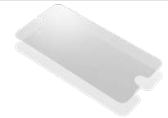

Data Capture
Trigger Handle
TRG-TC2Y-SNP1-01
TC21/TC26 Snap-On Trigger Handle
Transforms device into all-touch handle style terminal for use in interim high- volume scanning operations Easily attaches to TC21/TC26 top housing Exposed Contacts provide ability to charge with the 5- Slot & Single Slot Cradles Optional Wrist Tether (sold separately) 50-12500-066 The Trigger Handle is only available to be used on the TC21 and TC26 devices equipped with the 2-pin rear I/O connector. Does not block rear camera
Screen Protector
SG-TC2Y-SCRNPT1-01
TC21/TC26 Tempered Glass Screen Protector
Protects Display on TC21 & TC26 Single Protector to a Package
Trigger Handle Service Plan
The TC2X trigger accessory provides users with significant flexibility as they adapt the TC2X device to different operations within their retail environment. The TC2X trigger accessory is considered a consumable item which may need to be replaced during the life of a TC2X. Therefore, Zebra highly recommends the purchase of a Zebra trigger handle service plan. | OPT-TRGMNT-2 | 2-Year Zebra OneCare Comprehensive Trigger Maintenance
 | OPT-TRGMNT-3 | 3-Year Zebra OneCare Comprehensive Trigger Maintenance

Slide 6





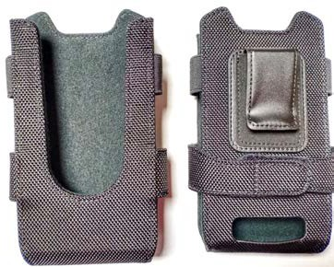
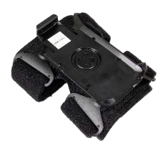
Soft Goods
Soft Holsters
SG-TC2Y-HLSTR1-01
TC21/TC26 Soft Holster
TC2X Open Bucket design to accommodate hand strap + Snap-on’s for easy insertion/removal Opening for audio & drainage Non-rotating clip Adjustable belt to fit the TC21/TC26 with Basic or Extended Battery
Hand Strap
SG-TC2Y-HSTRP1-01
TC21/TC26 Hand Strap
Plastic clip that snap into towel bar for easy insertion/removal Leather and Hypalon Pad for maximum comfort & wear resistance with Adjustable Velcro design
Arm Mount
SG-TC2Y-ARMNT-01
TC21/TC26 Arm Mount
Enables the TC21/TC26 to be mounted to the arm for hands free operation Scan with the hands free RS5100 Bluetooth Ring Scanner

Slide 7


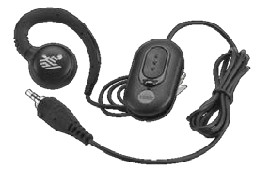
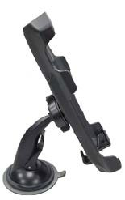

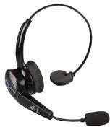

Audio and Vehicle Accessories
In-Vehicle Holder
CRD-TC2Y-VCH1-01 TC21/TC26 In-Vehicle Holder
Suction Cup for Easy Window or Dashboard Mount Supports device with 1X or 2X Batteries USB-C jack accessible Does Not support Snap-On Accessories Work with USB Cigarette Lighter Adapter (CHG-AUTO- USB1-01) – sold separately
Headset
HDST-35MM-PTVP-01
Over the ear headset with MIC and PTT 3.5mm Requires USB-C adapter cable, ADP- USBC-35MM1-0 (sold separately)
Bluetooth Headset
HS3100-OTH
HS3100 Rugged Bluetooth Headset Over-The- Head Headband includes HS3100 Boom Module and HSX100 OTH Headband Module
Audio Adapter Cable
ADP-USBC-35MM1-01
USB to 3.5MM adapter with PTT Headset button support

Slide 8


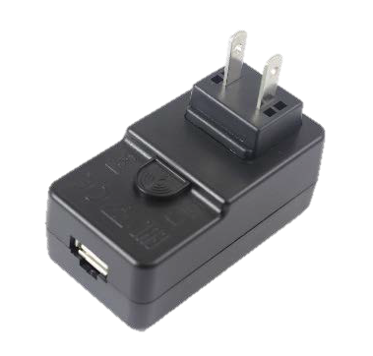
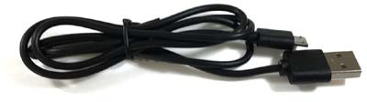
Chargers and Cables
USB C Cable
CBL-TC5X-USBC2A-01
Wall Charger – Power Supply
PWR-WUA5V12W0XX
Power Supply-100-240 VAC, 5 V, 2.5 A with country specific plugs.
TC21/TC26 USB C Cable to be used for charging and communications
Country
Power Supply Part Number
United States | PWR-WUA5V12W0US
Great Britain | PWR-WUA5V12W0GB
Europe | PWR-WUA5V12W0EU
Australia | PWR-WUA5V12W0AU
China | PWR-WUA5V12W0CN
Argentina | PWR-WUS5V12W0AR
Brazil | PWR-WUA5V12W0BR
Korea | PWR-WUA5V12W0KR
India | PWR-WUA5V12W0IN

Slide 9




AC Line Cords – Country Specific
CCoouunnttrryy | TThhrereeeWWiirree AACC LLiinneeCCoordrd
Abu Dhabi | 50-16000-220R: 1.8M long, CEE 7/7 plug
Australia | 50-16000-217R: 1.9M long, AS 3112 plug
Bolivia | 50-16000-220R: 1.8M long, CEE 7/7 plug
Brazil | 50-16000-727R: 18AWG, 250V, 16A, BR (3w)
China | 50-16000-217R: 1.9M long, AS 3112 plug 50-16000-257R: 1.8M long, IEC 60320 C13 plug
Dubai | 50-16000-220R: 1.8M long, CEE 7/7 plug
Egypt | 50-16000-220R: 1.8M long, CEE 7/7 plug
Europe | 50-16000-220R: 1.8M long, CEE 7/7 plug
Hong Kong | 50-16000-219R: 1.8M long, BS1363 plug
India | 50-16000-669R: 1.9M long, BS 546 plug
Iran | 50-16000-220R: 1.8M long, CEE 7/7 plug
Iraq | 50-16000-219R: 1.8M long, BS1363 plug
CCoouunnttrryy | TThhrereeeWWiirree AACC LLiinneeCCoordrd
Israel | 50-16000-672R: 1.9M long, S132 plug
Italy/Chile | 50-16000-671R: 1.8M long, CIE 23-16 plug
Japan | 50-16000-218R: 1.8M long, NEMA 1-15P plug
Korea | 50-16000-220R: 1.8M long, CEE 7/7 plug 50-16000-256R: 1.8M long, CEE7/7 plug
Malaysia | 50-16000-219R: 1.8M long, BS1363 plug
New Guinea | 50-16000-217R: 1.9M long, AS 3112 plug
Russia | 50-16000-220R: 1.8M long, CEE 7/7 plug
Singapore | 50-16000-219R: 1.8M long, BS1363 plug
UK | 50-16000-219R: 1.8M long, BS1363 plug
US | 23844-00-00R: 7.5 feet long 50-16000-221R: 1.8M long, USA NEMA 5-15P
Vietnam | 50-16000-220R: 1.8M long, CEE 7/7 plug

